Slide 1
Chapter 6
Network and Internet Security and Privacy

Slide 2
Learning Objectives
Explain network and Internet security concerns
Identify online threats

Slide 3
Understanding Security Concerns
Computer crime—or cybercrime—includes any illegal act involving a computer.
Cybercrime is a multibillion-dollar business that is often conducted by seasoned criminals.
All computer users should be aware of the security concerns surrounding computer network and Internet use, and they should take appropriate precautions.

Slide 4
Unauthorized Access and Unauthorized Use
Unauthorized access - whenever an individual gains access to a computer, network, file, or other resource without permission
Unauthorized use involves using a computer resource for unauthorized activities.
Codes of conduct - publish guidelines for acceptable behavior when using a computer as an employee, student, or other users.
Unauthorized access and many types of unauthorized use are criminal offenses in the United States and many other countries.

Slide 5
Hacking
Hacking – the act of breaking into a computer or network.
Typically, the motivation for hacking is to
steal data
sabotage a computer system
“hijack” a computer or network for use in an illegal or unethical act, such as generating spam or hosting pornographic Web sites.
Cyberterrorism—where terrorists launch attacks via the Internet.

Slide 6
War Driving and Wi-Fi Piggybacking
Wi-Fi networks are designed to provide wireless access to networks and the internet
Some estimates indicate that 70% of these networks are unsecured.
War driving typically involves driving in a car with a portable computer looking for unsecured Wi-Fi networks to connect to.
Wi-Fi piggybacking refers to accessing someone else’s unsecured Wi-Fi network from the hacker’s current location

Slide 7
Interception of Communications
Some criminals gain unauthorized access to unsecured data, files, email messages, VoIP calls, and other content as it is being sent over the Internet.
Proprietary corporate information and sensitive personal information is at risk if it is sent unsecured over the Internet or over a wireless home or corporate network.
A new trend is criminals intercepting unsecured credit and debit card information during the card verification process; that is, intercepting the data from a card in real time as a purchase is being authorized.

Slide 8
Online Threats
Topics Covered:
Botnets
Computer Viruses and Other Types of Malware
Denial of Service (DoS) Attacks
Data, Program, or Web Site Alteration
Online Theft, Online Fraud, and Other Dot Cons
Theft of Data, Information, and Other Resources
Identity Theft, Phishing, and Pharming
Protecting Against Identity Theft
Online Auction Fraud and Other Internet Scams

Slide 9
Botnets
A computer that is controlled by a hacker or other computer criminal is referred to as a bot or zombie computer.
A group of bots that are controlled by one individual and can work together in a coordinated fashion is called a botnet.
According to the FBI, an estimated one million U.S. computers are currently part of a botnet.

Slide 10
Malware
Short for malicious software, is software designed to infiltrate a computer system without the owner's informed consent.
Malware is a general term for;
Viruses
Worms
Trojan horses
Sypware
Dishonest addware
Crimeware
Rootkits

Slide 11
Computer Virus
Computer program designed to copy itself into other programs, with the intention of causing mischief or damage
A virus is loaded into a computer's memory and instructs its host program to copy the viral code into any number of other programs and files stored in the computer.
When the program is started or the file is accessed a fatal error occurs usually causing the program to shut down or in rare cases the computer to crash.

Slide 12
Worms
A computer worm is a type of virus that replicates itself, but does not alter any files on your machine.
Worms cause havoc by multiplying so many times that they take up all your computer's available memory or hard disk space.
This can lead to denial of service.

Slide 13
Trojan horses
A Trojan horses is a software programs that masquerade as a regular program, such as games, disk utilities, and even antivirus programs.
A Trojan horse might appear to be a computer game, but once you double-click it, the program starts writing over certain parts of your hard drive, corrupting your data.

Slide 14
Spyware
As the name implies, this is software that "spies" on your computer
Spyware can capture information like Web browsing habits, e-mail messages, usernames and passwords, and credit card information.
If left unchecked, the software can transmit this data to another person's computer over the Internet.

Slide 15
Preventing Malware from Infecting Your Computer
Install an antivirus program on all of your computers
Never open an e-mail attachment unless you are expecting it and it is from a trusted source
If the antivirus program flags an e-mail attachment as infected, delete the attachment immediately
Check all downloaded programs for viruses, worms, or Trojan horses

Slide 16
Anti-virus Programs
Identifies and removes computer viruses
Most also protect against worms and Trojan horses
Most anti-virus programs provide more then just virus protection.

Slide 17
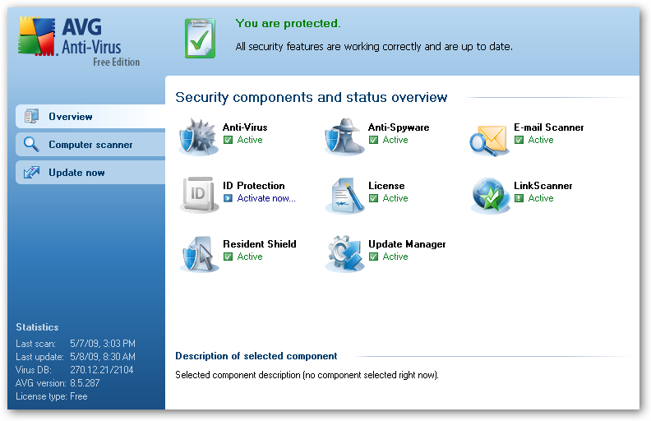
Anti-virus Programs

Slide 18
Denial of Service (DoS) Attacks
A denial of service (DoS) attack is an act of sabotage that attempts to flood a network server or Web server with so many requests for action that it shuts down or simply cannot handle legitimate requests any longer, causing legitimate users to be denied service.
DoS attacks today are often directed toward popular sites and typically are carried out via multiple computers known as a distributed denial of service (DDoS) attack.

Slide 19
Data, Program, or Web Site Alteration
Another type of computer sabotage occurs when a hacker breaches a computer system to delete or modify
data
programs
Data on Web sites can also be altered by hackers, for instance, individuals sometimes hack into and alter other people’s social networking accounts.

Slide 20
Dot Cons
A booming area of computer crime involves online fraud, theft, scams, and related activities designed to steal money or other resources from individuals or businesses—these are collectively referred to as dot cons.

Slide 21
Theft of Data, Information, and Other Resources
Data theft or information theft is the theft of data or information located on or being sent from a computer.
It can be committed by
stealing an actual computer
it can take place over the Internet or a network by an individual gaining unauthorized access to that data by hacking into the computer or by intercepting the data in transit.
Direct theft of money through the internet is a growing issue

Slide 22
Identity Theft, Phishing, and Pharming
Identity theft occurs when someone obtains enough information about a person to be able to masquerade as that person—usually to buy products or services in that person’s name.

Slide 23
Identity Theft, Phishing, and Pharming
Skimming involves stealing credit card or debit card numbers by using an illegal device attached to an ATM or credit card reader
Phishing (pronounced fishing)is the use of a spoofed email message to trick the recipient into revealing sensitive personal information, such as credit card numbers.
More targeted, personalized phishing schemes are known as spear phishing.
Pharming is another type of scam that uses spoofed domain names to obtain personal information for use in fraudulent activities.

Slide 24
Protecting Your Identity.
Disclosing personal information only when it is necessary and only via secure Web pages.
Use security software and keep it up to date
Shred the preapproved credit card offers and other documents containing personal information that frequently arrive in the mail before recycling them.
Never click a link in an email message to go to a secure Web site—always type the URL for that site in your browser

Slide 25
Protecting Your Identity.
Protect your Social Security number and give it out only when necessary..
Keep a close eye on your credit card bills and credit history.
Ordering a full credit history on yourself a few times a year to check for accounts listed in your name that you did not open and any other problems.
You can also use browser-based antiphishing tools and digital certificates to help guard against identity theft and the phishing and pharming schemes used in conjunction with identity theft.

Slide 26
Buying Online
Make sure that when you enter the shopping cart are the address changes to https://- secure socket layer
Look for the following logos at the bottom of the home page of the merchants Web site.

Slide 27

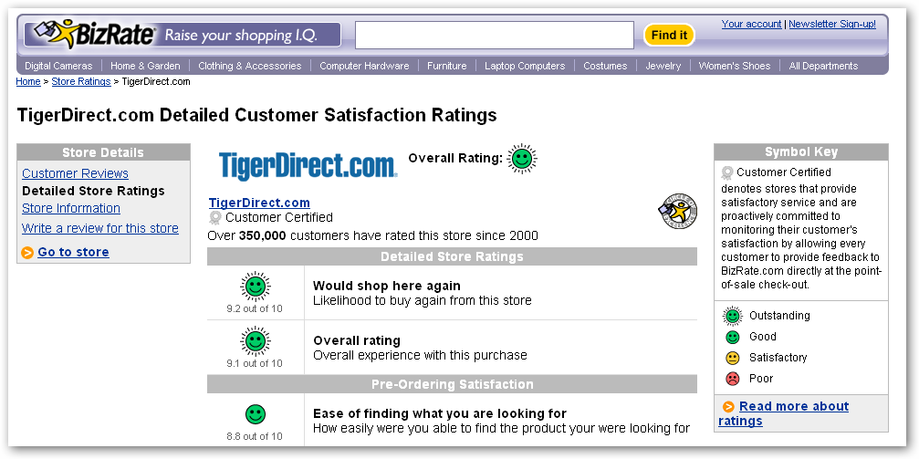
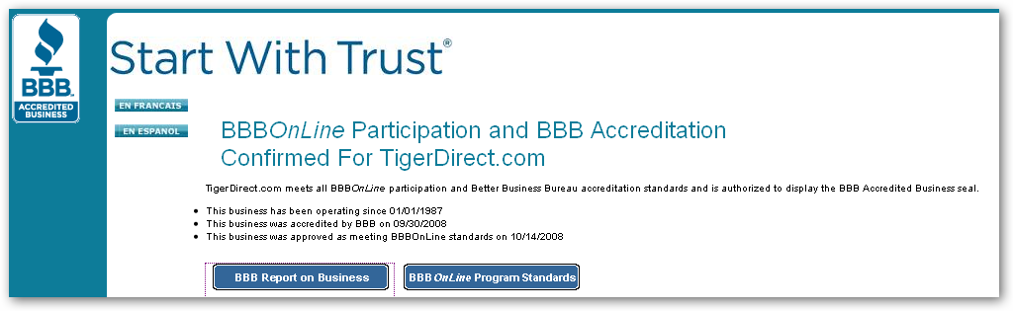
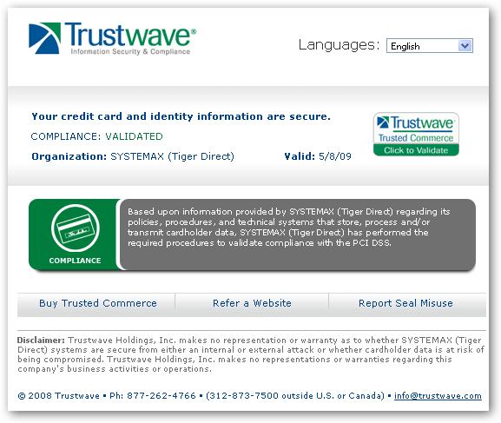
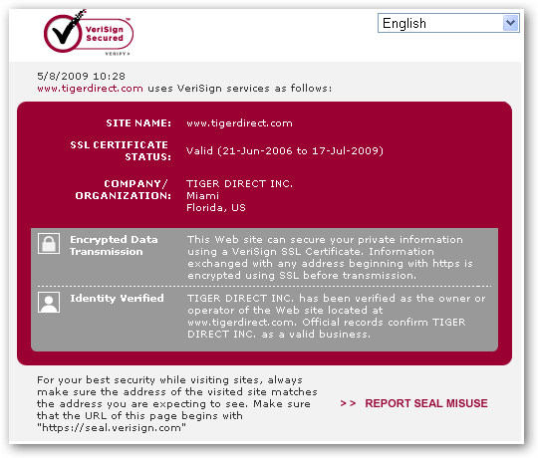



Buying Online -Certification

Slide 28
Online Auction Fraud and Other Internet Scams
Online auction fraud (sometimes called Internet auction fraud) occurs when an online auction buyer pays for merchandise that is never delivered, or that is delivered but it is not as represented.
The best protection against many dot cons is common sense.

